Slide 1
Graph Terminology &
Representation
Instructor : Saifur Rahman

Slide 2
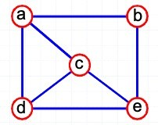
What is a Graph?
A graph is a pair (V, E), where
V is a set of nodes, called vertices
E is a collection of pairs of vertices, called edges
V(G) and E(G) represent the sets of vertices and edges of G, respectively
Example:
V= {a, b, c, d, e}
E= {(a,b), (a,c), (a,d),
(b,e), (c,d), (c,e), (d,e)}
A tree is a special type of graph!

Slide 3
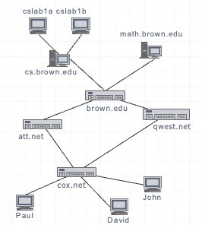
Applications
Electronic circuits
Printed circuit board
Integrated circuit
Transportation networks
Highway network
Flight network Computer networks
Local area network
Internet
Web
Databases
Entity-relationship diagram

Slide 4
What can we do with graph?
Find a path from one place to another
Find the shortest path from one place to another
Determine connectivity
Find the “weakest link” (min cut)
check amount of redundancy in case of failures
Find the amount of flow that will go through them

Slide 5
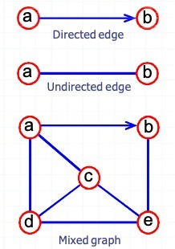
Edge and Graph Types
Directed edge
ordered pair of vertices (u,v)
first vertex u is the origin
second vertex v is the destination
Undirected edge
unordered pair of vertices (u,v)
Directed graph (Digraph)
all the edges are directed
e.g., route network
Undirected graph
all the edges are undirected
e.g., flight network
Mixed graph
some edges are undirected and some edges are directed
e.g., a graph modeling a city map

Slide 6
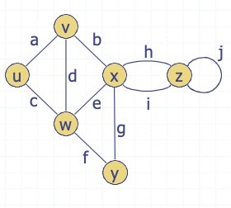
Terminology
End vertices (or endpoints) of an edge
u and v are the endpoints of a
Edges incident to a vertex
a, d, and b are incident to v
Adjacent vertices
u and v are adjacent
Degree of a vertex
x has degree 5
Parallel edges
h and i are parallel edges
Self-loop
j is a self-loop

Slide 7
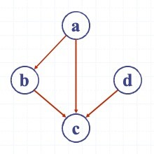
Terminology
Out-degree : Outgoing edges of a vertex
(a, b) and (a, c) are outgoing edges of vertex a
In-degree : Incoming edges of a vertex
(b, c), (d, c) and (a, c) are incoming edges of vertex c
In-degree of a vertex
c has in-degree 3
b has in-degree 1
Out-degree of a vertex
a has out-degree 2
b has out-degree 1

Slide 8
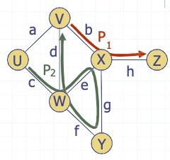
Terminology
Path
sequence of alternating vertices and edges
begins with a vertex
ends with a vertex
each edge is preceded and followed by its endpoints
Simple path
path such that all its vertices and edges are distinct
Examples
P₁=(V , b , X , h , Z)
is a simple path
P₂=(U, c, W , e, X, g, Y, f , W , d , V)
is a path that is not simple

Slide 9
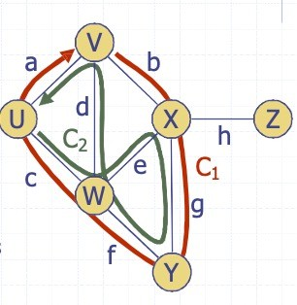
Terminology
Cycle
A cycle is a path whose start and end vertices are the same
each edge is preceded and followed by its endpoints
Simple cycle
A cycle is simple if each edge is distinct and each vertex is distinct,
except for the first and the last one
Examples
C₁=(V, b, X, g, Y, f, W, c, U, a, V)
is a simple cycle
C₂=(U,c,W,e,X,g,Y,f,W,d,V,a,U)
is a cycle that is not simple

Slide 10
Terminology
Dense graph: |E| ≈ |V|²; Sparse graph: |E| ≈ |V|
A weighted graph associates weights with either the edges or the vertices
A complete graph is a graph that has the maximum number of edges
for undirected graph with n vertices, the maximum number of edges is
n(n-1)/2
for directed graph with n vertices, the maximum number of edges is n(n-1)

Slide 11
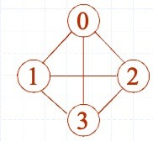
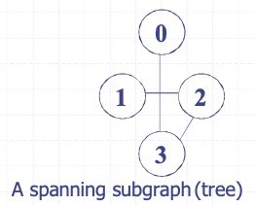
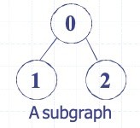
Terminology
A subgraph of G is a graph G’ such that
V(G’) is a subset of V(G) [V(G’) ⊆ V(G)] and
E(G’) is a subset of E(G) [E(G’) ⊆ E(G)]
A spanning subgraph G’ of G is a subgraph of G that contains all the vertices of G, that is
V(G’) is equal to V(G) [V(G’) = V(G)] and
E(G’) is a subset of E(G) [E(G’) ⊆ E(G)]
A forest is a graph without cycles.
A tree is a connected forest, that is, a connected graph without cycles.
A spanning tree of a graph G is a spanning subgraph that is a (free) tree.

Slide 12
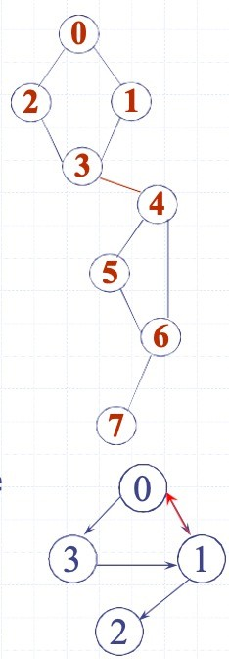
Terminology
In a graph G, two vertices, v₀ and v₁, are connected if there is a path in G from v₀ to v₁
A graph is connected if, for every pair of distinct vertices v_{i} and v_{j}, there is a path from v_{i} to v_{j}
A connected component of an undirected graph is a maximal connected subgraph.
A tree is a graph that is connected and acyclic.
A directed graph is strongly connected if there is a directed path from v_{i} to v_{j} and also from v_{j} to v_{i}.
A strongly connected component is a maximal subgraph that is strongly connected.

Slide 13
Properties
Property 1
For an undirected graph
Sv deg(v) = 2m
Proof: each edge is counted twice
Property 3
If G is a simple undirected graph,
then m ≤ n(n - 1)/2, and if G is a simple directed graph, then m ≤ 𝒏(n - 1).
Proof: each vertex has degree at most (n - 1). Then use Property 1 and Property 2.
Property 2
For a directed graph
Sv indeg(v) = Sv outdeg(v) = m
Proof: each for out-degreeedge is counted once for in-degree and once

Slide 14
Graph Representation

Slide 15
Graph Representations
For graphs to be computationally useful, they have to be conveniently represented in programs
There are two computer representations of graphs:
Adjacency matrix representation
Adjacency lists representation

Slide 16
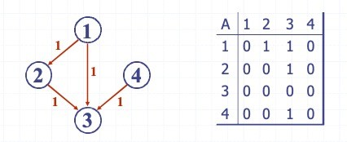
Adjacency Matrix Representation
Assume V = {1, 2, …, n}
An adjacency matrix represents the graph as a n xn matrix A:
A[i, j ] = 1 if edge (i, j) ∈ E
= 0 if edge (i, j) ∉ E
(or weight of edge)

Slide 17
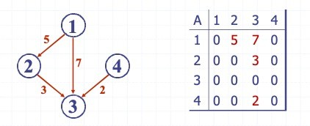
Adjacency Matrix Representation
Assume V = {1, 2, …, n}
An adjacency matrix represents the graph as a nxn matrix A:
A[i, j ] = 1 if edge (i, j) ∈ E
= 0 if edge (i, j) ∉ E
(or weight of edge)

Slide 18
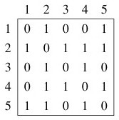
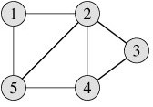
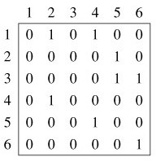
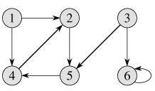
Adjacency Matrix Representation
The adjacency matrix for an undirected graph is symmetric;
The adjacency matrix for a digraph need not be symmetric

Slide 19
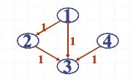
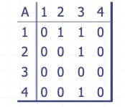
Adjacency Matrix Representation
Pros:
Simple to implement
Easy and fast to tell if a pair (i, j) is an edge: simply check if A[i, j] is 1 or 0
Can be very efficient for small graphs
Cons:
No matter how few edges the graph has, the matrix takes O(n²) in memory

Slide 20
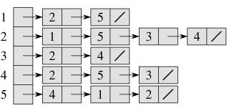
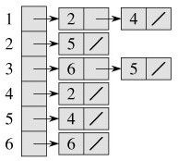
Adjacency List Representation
A graph is represented by a one-dimensional array L of linked lists, where
L[i] is the linked list containing all the nodes adjacent to node i.

Slide 21
Adjacency List Representation
Pros:
Saves on space (memory): the representation takes O(|V|+|E|) memory.
Good for large, sparse graphs (e.g., planar maps)
Cons:
It can take up to O(n) time to determine if a pair of nodes (i, j) is an edge: one would have to search the linked list L[i], which takes time proportional to the length of L[i].

Slide 22
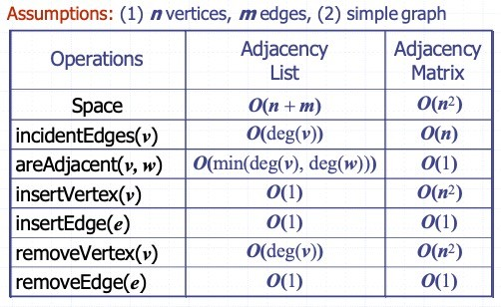
Asymptotic Perfromance

Slide 23
Thank You

